Slide 1

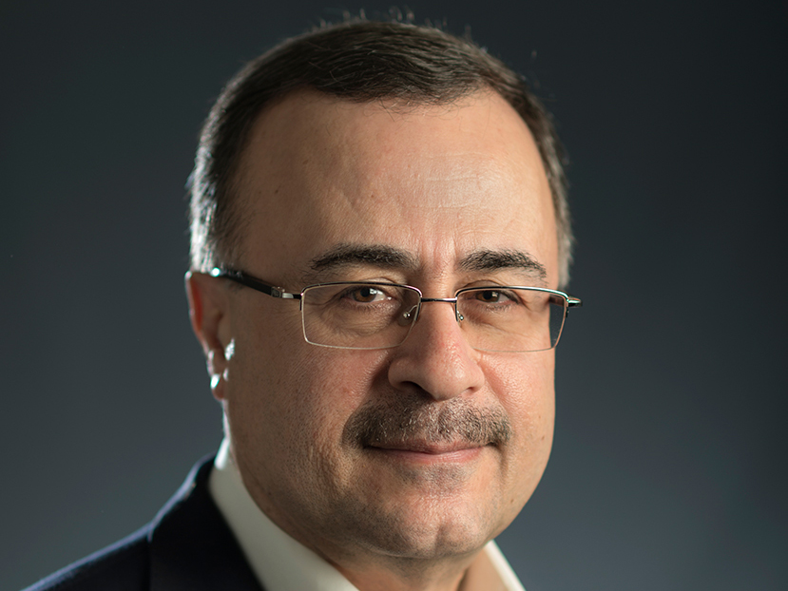
ANALYSIS OF THE LEADERSHIP COMPETENCIES OF AMIN H. NASSER, PRESIDENT & CEO OF SAUDI ARAMCO
GROUP WORK

Slide 2
INTRODUCTION
This presentation examines the leadership approach and methods of Mr. Amin H. Nasser, CEO and President of Saudi Aramco.
The presentation is a compilation of the different theories of leadership which are used as different lenses to examine and review the leader of interest.
This comprehensive report examines different leadership approaches and mechanisms which are used to explain the leader’s approaches.
Each team member focused on one or a combination of leadership theories to explain the nature, success and features of Mr. Nasser’s leadership style.

Slide 3
BACKGROUND OF MR. AMIN H. NASSER
He completed a degree program in Petroleum Engineering at the King Fahd University and joined Saudi Aramco in 1982 (Kear, 2020).
He held various managerial positions until he rose to head Saudi Aramco’s upstream operations in 1989 (Kear, 2020).
Mr. Amin Nasser was appointed president and CEO in 2015.
He has also played a major role in linking Saudi Aramco to Saudi Arabia’s Vision 2030 which seeks to reform the economy and promote investments through the Saudi Tadawul stock exchange.
Great diplomatic skills that has helped to promote Saudi Arabia’s place in balancing OPEC and Non-OPEC activities and procedures.

Slide 4
MAIN ACHIEVEMENTS OF MR. AMIN H. NASSER
Rapid expansion and global growth of Saudi Aramco since 2015 when he took over.
Launching the world’s largest IPO in 2019 which led to the merger of the largest petrochemical company in the world.
Taking Saudi Aramco public and causing shares to be sold on the Saudi Tadawul which boosted investor confidence in Saudi Arabia.
Proper handling of the unprecedented terrorist attacks on the Abqaiq processing plants and Khurais oil field in September 2019 which ensured minimal disruption and the setting of blueprints and precedents for future events of that nature.

Slide 5
METHODOLOGY OF THE GROUP PROJECT
Team members were encouraged to do personal research about the leadership processes and procedures of Mr. Amin Nasser.
Members were encouraged to dig deeper and find information about how Mr. Nasser achieved these feats
Ascertain how the theories and concepts of leadership identified in the course can be linked to the achievements of Mr. Nasser.
Team members wrote their leadership analysis of Mr. Nasser. These contributions are presented below in the different sections below.
After submissions were made, there was a presentation of views by team members. This was a form of peer review that ensured that the submissions of team members were critiqued and this is inserted at the end of each section.

Slide 6
TRANSFORMATIONAL LEADERSHIP
Transformational Leadership | Amin Nasser
Setting organizational goals with followers | Amin Nasser got people to take part in decision making and choices
Integrating people’s goals into company goals | Amin Nasser made it clear that the future was jointly held
Motivation and great communication | Amin Nasser could summarize things and present strong inputs that people at all levels understood.
Trust and mutual respect | Amin Nasser highlighted minor gains and always used the best techniques that produced results.

Slide 7
BEHAVIORAL / STYLE THEORY OF LEADERSHIP
Behaviour Theory | Amin Nasser’s Saudi Aramco
Great leaders are not born as leaders | He was born into a poor working-class family
Great leaders learn and build habits | He made a conscious effort to learn and develop the right behaviour
Learning and relearning creates leadership behaviour | Proximity to the company helped him to gain association, environmental stimuli and intimate knowledge of occurrences
Leadership behaviour brings trust | People trust him because he has learnt and his leadership style brings results
Trust and cooperation brings results | His statements are credible and this erases doubts and the people just contribute to his vision.

Slide 8
GREAT MAN THEORY + BUREAUCRATIC LEADERSHIP
Great Man Theory | Amin Nasser
Supernormal | Graduated with excellent grades
Respected | Everyone recognises his achievements and his Saudi roots brings fame to him
Resourceful | Gains results and has evidence to prove it
Bureaucratic/Rational-Legal Leadership
Education | Trained at a leading institution
Experience | Has served the company with great results for almost 40 years
Ethics | Upholds the highest levels of ethics throughout career and continues to encourage high levels of ethical responsibility

Slide 9
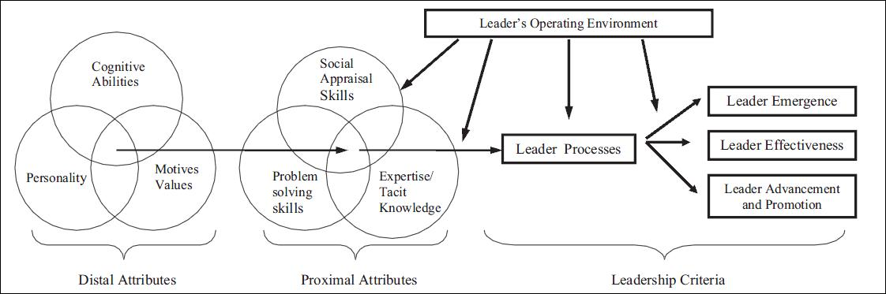
TRAIT THEORY OF LEADERSHIP MODEL (ZACCARO ET AL, 2004)

Slide 10
TRAIT THEORY OF LEADERSHIP & AMIN H. NASSER
Distal Attributes | Amin H. Nasser
Personality | He has a trusted personality that he has cultivated over many years
Motives | He understands what drives every employee
Cognitive | He has great diagnostic abilities due to his experience
Proximal Attributes
Social Appraisal | Emotional intelligence and strong interpersonal and diplomatic skills
Problem Solving | Ability to solve technical and other related issues
Expertise/Tacit Knowledge | Credibility gained over 30 years of work with the company
Leadership Criteria
Emergence | Great understanding of issues that come up evidenced by the 2019 terrorist attack on an Aramco facility
Effectiveness | Great input-output goal setter
Progress | Innovative on all levels

Slide 11
MANAGERIAL THEORY / TRANSACTIONAL LEADERSHIP
Managerial Theory | Amin Nasser
Transactional Leadership | Most people in contracts with Saudi CEO respect Amin Nasser because of what they stand to lose if they do not honour their part of the bargain
Planning and Forecasting | Amin Nasser is good at planning and implementing goals and this is strongly linked to his history as a long-time executive of the company
Implementation of Strategy | He succeeds in implementing the right strategies and goals
Hiring and Firing Ability | People respect Amin Nasser because he can hire and fire them. When he leaves the position and does not have the same powers, he is most likely to be judge differently.

Slide 12
RELATIONAL THEORY OF LEADERSHIP
Relational Theory of Leadership | Amin Nasser
People factor | Amin Nasser has a relative stronger relationship with the people and they trust and love him more.
Plural discourses | Amin Nasser has the ability to build expectations and get the people to see things from their own personal position, and the company’s position.
Agency and Participation | Amin Nasser is able to create a strong rapport that gets people to give off their best through improved motivation among others
Concern for People | High
Concern for Production | High

Slide 13
KEY LESSONS LEARNT BY THE TEAM
What we learnt collectively at the end of this exercise is that leadership is not a one-size-fits all matter. There are many different dimensions of leadership and while some might view leadership in one dimension, others would view it differently.
Each group member learnt another social construct on the nature of leadership. This is because some of our colleagues presented dimensions and theories of leadership that we did not even know about. However, due to the nature of their expression and explanations, we got to learn that there are many lenses through which leadership can be analysed and understood.

Slide 14
QUESTION & ANSWERS

Slide 15
REFERENCES
Kear, K., 2020. Amin Nasser, President and Chief Executive officer of Saudi Aramco named Energy Intelligence's Energy Executive of the Year for 2020. [Online] Available at: https://www.energyintel.com/pages/eey-2020.aspx [Accessed 4 April 2021].
Zaccaro, S. J., Kemp, C. & Bader, P., 2004. Leader traits and attributes. In: The nature of leadership. Thousand Oaks, CA, US: Sage Publications, Inc, pp. 101-124.

